Slide 1
Advanced Algorithms
Weiwei Wu

Slide 2
Outline
Optimization: the target of most algorithms in CS
Concepts in algorithm design
  Basic: polynomial time, optimality
  Advanced: Approximation/Competitive
    ratio, offline, online, worst case, average case
This week
  Optimality through dynamic programming
    Classic example: knapsack, LCS, interval scheduling
    Research example: Schedule in Cloud Computing [min active time] (open for you)
  Approximation examples
    Classic example: Knapsack, min makespan
    Research example: related min makespan, min active time

Slide 3
Optimality through dynamic programming
Introduction to dynamic programming
  Concept: build up the solution from the subproblems
  Idea: make sure whenever you need the answer for a subproblem, it is ready
  Key: problem structure
    How to define your subproblems
    How to divide you problem to subproblems
Key to learn:
  how does DP work
  how to design DP for your problem

Slide 4
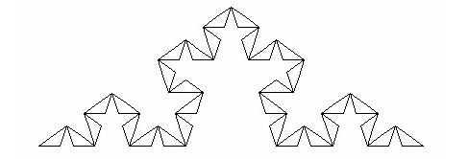
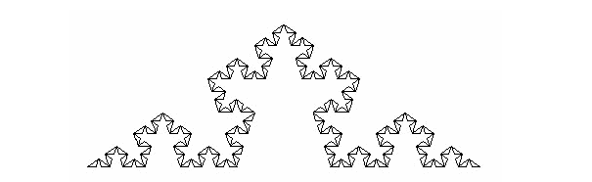
What is subproblem? Imagine as fractal
Fractal geometry:
How to reuse subproblem:
  got an element/compoent and combine,
  what kind of element it could be?
  E.g. the minimum one (triangle), the second last minimum one (pentagon/pentagram)

Slide 5
Optimality through dynamic programming
---how does DP work
Problem: honoi tower problem
Q: dynamic programming solution
  What is the possible subproblem?
  How to move?

Slide 6
Optimality through dynamic programming
---how does DP work
Problem: honoi tower problem
Q: dynamic programming solution
    MOVE(N)=2MOVE(N-1)+1
Running process of the DP algorithm
  Top-down
  Bottom up

Slide 7
Optimality through dynamic programming
---how does DP work
Problem: interval scheduling
  1 machine/or classroom
  n classes: each with start time r_i, deadline d_i
  Pack the classes over one day
  unweigted/weighted
  Obj: max the number/value
  Application
Unweighted:
  What if earliest arrvial?
  What if shortest first? Counter example
Q: dynamic programming solution
  See also: 2nd_lecture.pdf
    Q: optimality?
    Thinking: multiple machines?

Slide 8
Optimality through dynamic programming
--how to design DP for your problem
Problem: knapsack
  1 bag with size C
  n items: each with size c_i, value v_i
  Pack the items with total size at most C
  Obj: max the value
  Applications: memory, register, space, VM…
Q: dynamic programming solution
Pls try to develop it by yourself, based on the concept of “fractal”: partition and resue/combine

Slide 9
Optimality through dynamic programming
Problem: knapsack
  1 bag with size C
  n items: each with size c_i, value v_i
  Pack the items with total size at most C
  Obj: max the value
Q: dynamic programming solution
  Q1: what does the function look like?
  Q2: what is the subproblem in high level?

Slide 10
Optimality through dynamic programming
Problem: knapsack
  1 bag with size C
  n items: each with size c_i, value v_i
  Pack the items with total size at most C
  Obj: max the value
Q: dynamic programming solution
  Q1: what does the function look like?
  Q2: what is the subproblem in high level?
  Q3: the function? Think about the last item to add
  Q4: loop over which variant
  Q5: the function?
      Knapsack(i，c)=max{ knapsack(i-1,c), knapsack(i-1, c-c_i)+v_i}

Slide 11
Optimality through dynamic programming
Problem: knapsack
  1 bag with size C
  n items: each with size c_i, value v_i
  Pack the items with total size at most C
  Obj: max the value
Q: dynamic programming solution
  Q1: what does the function look like?
  Q2: what is the subproblem in high level?
  Q3: the function? Think about the last item to add
  Q4: loop over which variant
  Q5: the function?
      Knapsack(i，c)=max{ knapsack(i-1,c), knapsack(i-1, c-c_i)+v_i}
  Q6: what if the index i is removed?
    Reduce ?
  Q7: think about the order? Order matters?

Slide 12
Optimality through dynamic programming
Problem: knapsack
  1 bag with size C
  n items: each with size c_i, value v_i
  Pack the items with total size at most C
  Obj: max the value
Q: dynamic programming solution
  Q1: what does the function look like?
  Q2: what is the subproblem in high level?
  Q3: the function? Think about the last item to add
  Q4: loop over which variant
  Q5: the function?
      Knapsack(i，c)=max{ knapsack(i-1,c), knapsack(i-1, c-c_i)+v_i}
  Q6: what if the index i is removed?
    Reduce ? space but not time
  Q7: think about the order? Order matters?

Slide 13
Optimality through dynamic programming
Problem: knapsack
  1 bag with size C
  n items: each with size c_i, value v_i
  Pack the items with total size at most C
  Obj: max the value
Q: dynamic programming solution
  Q1: what does the function look like?
  Q2: what is the subproblem in high level?
  Q3: the function? Think about the last item to add
  Q4: loop over which variant
  Q5: the function?
  Q6: what if the index i is removed?
  Q7: think about the order? Order matters?
  Q8: what is the role of the index i? exponential vs poly
  Q9: can we remove the index i? run an instance

Slide 14
Optimality through dynamic programming
Problem: knapsack
  1 bag with size C
  n items: each with size c_i, value v_i
  Pack the items with total size at most C
  Obj: max the value
Q: dynamic programming solution
  Optimality? Bottom-up, tree-structure tracking to max/exist path,
  Last Q: do you find how this problem ‘was’ solved?
  DC vs. DP?

Slide 15
Optimality through dynamic programming
Problem: knapsack
  1 bag with size C
  n items: each with size c_i, value v_i
  Pack the items with total size at most C
  Obj: max the value
Q: dynamic programming solution
  Optimality? Bottom-up, tree-structure tracking to max/exist path,
  Last Q: do you find how this problem ‘was’ solved?
  DC vs. DP?
  reuse, bottom up, mergsort

Slide 16
Optimality through dynamic programming
Problem from research:
min active time for data center
  1 machine with state active/idle: Capacity C units of resources.
  n tasks: each task j (consumes one unit of resource each) with
    Processing time p_j
    Release time r_i
    Deadline d_i
  Allocate the tasks with intersection (C=\inf), that is, the conflict is allowed, which is different with the original interval scheduling problem
    If p_i=d_i-r_i, then the solution/OPT is unique
    But now P_i\le d_i-r_i, what is the optimal solution
  Obj: min total active value, so that other time slots can be shut-down to reduce waste, energy, a key concern in operating datacenter
Q: what is the dynamic programming solution
  open for you: how to reduce from exponential to polynomial
Tips: is there another DP for the weighted interval scheduling?

Slide 17
Optimality through dynamic programming
Problem from research:
min active time for data center
  1 machine with state active/idle: Capacity C units of resources.
  n tasks: each task j (consumes one unit of resource each) with
    Processing time p_j
    Release time r_i
    Deadline d_i
  Allocate the tasks with intersection (C=\inf), that is, the conflict is allowed, which is different with the original interval scheduling problem
    If p_i=d_i-r_i, then the solution/OPT is unique
    But now P_i\le d_i-r_i, what is the optimal solution
  Obj: min total active value, so that other time slots can be shut-down to reduce waste, energy, a key concern in operating datacenter
Q: what is the dynamic programming solution
  open for you: how to reduce from exponential to polynomial
Tips: is there another DP for the weighted interval scheduling?
  Think about OPT(L,R,n) where [L,R] is the interval

Slide 18
Approximation: concept introduction through classic examples
Approximation: concept
  Min problem
  Input: an instance
  Output: a solution
  Worst case bound: any instance
    Q: what does the OPT look like?
    how can it possible?
  Q: use xx to exchange xx?
  Q: max problem?

Slide 19
Approximation: concept introduction through classic examples
Approximation: example
  Problem: knapsack
    Recall the setting
    Q: what will you do to gain as more as possible?

Slide 20
Approximation: concept introduction through classic examples
Approximation: example
  Problem: knapsack
    Recall the setting
    Q: what will you do to gain as more as possible?
    Q: greedy? In what?
      What if largest value first?
      What if smallest size first? counter examples
      What if proportional first?
    Q: roughly evaluate the solution?
    Q: can it be bad?

Slide 21
Approximation: concept introduction through classic examples
Approximation: example
  Problem: knapsack
    Recall the setting
    Q: what will you do to gain as more as possible?
    Q: greedy? In what? Value, size, or …
    Q: roughly evaluate the solution?
    Q: can it be bad?

Slide 22
Approximation: concept introduction through classic examples
Approximation: example
  Problem: knapsack
    Recall the setting
    Q: what will you do to gain as more as possible?
    Q: roughly evaluate the solution?
    Q: can it be bad?
    Q: how to improve or avoid bad?
    Q: double check?

Slide 23
Approximation: concept introduction through classic examples
Approximation: example
  Problem: knapsack
    Recall the setting
    Q: what will you do to gain as more as possible?
    Q: roughly evaluate the solution?
    Q: can it be bad?
    Q: how to improve or avoid bad?
    Q: double check?
    Q: how far can it be away from the optimal solution?
      Wha t are the properties of the Max strategy
      How far
      Why
    Q: leave open--greedy advanced analysis

Slide 24
Approximation: concept introduction through classic examples
Approximation: example
  Problem: makespan for identical machine
    m identical machines
    n tasks: each with length l_i
    makespan: maximum completion time
    Goal: min makespan

Slide 25
Approximation: concept introduction through classic examples
Approximation: example
  Problem: makespan for identical machine
    Q: what will you do to gain as more as possible?
    Q: roughly evaluate the solution?
    Q: can it bad?
    Q: how far can it be away from the optimal solution?
      How far
      Why
    Q: leave open—related machine with speed s_j

Slide 26
Approximation: concept
Competitiveness: concept
  online vs offline
  Input: an instance
  Output: a solution
  Worst case bound: any instance at each time
    Q: what does the OPT look like?
    how can it possible?
    How good can it be?

Slide 27
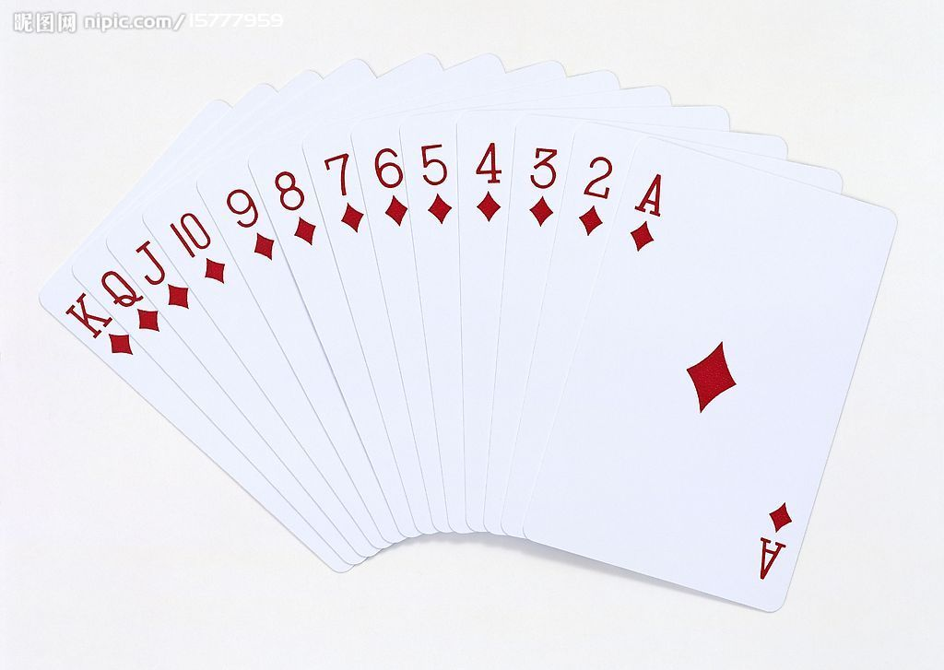
Approximation: concept
Competitiveness: example
  Problem: poker game
    you vs me
    range[1,13]
    I release the poker online
    u draw k times (e.g. n=10,k=3)
    Goal: gain as much as possible
  Alg
  Adversary

Slide 28

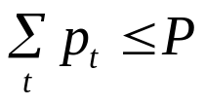
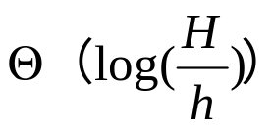



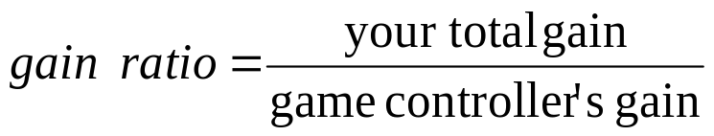
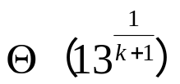
related paper
Network power allocation:
  Online sequence:
  Power budget:
  Time slot t: allocate
  Maximize:
  ALG: R=r^{k+1}; r^1 r^2 r^3 r^k

Slide 29
Approximation/competitive concepts
Problem from research:
online min active time for data center
  1 machine with state active/idle
  n tasks: each task j with
    Processing time p_j
    Release time r_i
    Deadline d_i
  Allocate the tasks with intersection
  Allocate when arrival
  Obj: min total active value
Q: what are the approximation/competitive algorithms
Q: bad example?
  open for you: how to make ‘fast’ offline/online decision

Slide 30
Mobile System, mechanism design and competitiveness
http://cse.seu.edu.cn/people/weiweiwu
weiweiwu@seu.edu.cn
Notes:
Combinatorial Optimization in Action
Flying a plane, riding a bus, buying a writing pad, or making a
phone call: Can you imagine that combinatorial optimization has
something to do with these activities? This lecture will provide
answers and show how the techniques of discrete mathematics
influence our daily life.
Combinatorial optimization in action
Combinatorial optimization exploded on the mathematical and scientific scene in the 1950s. In this lecture I will briefly survey its development for a wide audience. Theoretical design and analysis of algorithms dominated the early development of the field, while computational progress has been particularly significant in the last twenty years. These theoretical and computational achievements, combined with successful modeling of applications, have made it possible today to solve real-world problems of breathtaking size and diversity. The majority of the lecture will report on success stories in areas such as telecommunication, transportation, traffic and logistics. These results are based on ongoing cooperation between industry, the DFG Research Center MATHEON and my research group at Konrad-Zuse-Zentrum (ZIB).

Slide 31
Recap: big O, Ω
T(n)= O(f(n))：
  If there exists c > 0 & integer n_0≥1，such that T(n)≤c*f(n) for any n≥n_0
  e.g. T(n)=3n^3+2n^2，… , ∴T(n)= O(n^3)
Ω
10^9/s，n=60
Complexity： n n^2 n^3 n^5 2^n 3^n
Time: 6*10-8s 3.6*10-6s 2.16*10-4s 0.013min 3.66century 1.3*1013century

Slide 32
Recap: big O, Ω
T(n)= O(f(n))：
  If exists c > 0 & integer n_0≥1，such that T(n)≤c*f(n) for any n≥n_0
  e.g. T(n)=3n3+2n2，… , ∴T(n)= O(n3)
Ω
10^9/s，n=60
complexity n n^2 n^3 n^5 2^n 3^n
Time: 6*10-8s 3.6*10-6s 2.16*10-4s 0.013min 3.66century 1.3*1013century
Insertion sort
Binary sort

Slide 33
Why poly(n) important
E.g. 10^9/s，n=60
complexity n n^2 n^3 n^5 2^n 3^n
Time: 6*10-8s 3.6*10-6s 2.16*10-4s 0.013min 3.66century 1.3*1013century

Slide 34
Possible solving directions
If the problem is poly(n) computable
  Find polynomial time algorithms
  Reduce the time complexity : O(n^2)→O(n^logn)
  Find approximate solution with even faster algorithm
If the problem is difficult
  Prove the problem is NP-hard (mostly)
  Find polynomial time approximation algorithms
    tradeoff the gain with time
  Improve approximation ratio
  Find PTAS → (1+ε) – approximation (weak poly)
  Find FPTAS → (1+ε) – approximation (strong poly)
Prove the hardness of approximation

Slide 35
Network power allocation:
  Online sequence:
  Power budget:
  Time slot t: allocate
  Maximize:
Toy example: Porker game: you vs. game controller
  value range [1-13]
  each time 1 card is released (by game controller)
  n cards will be released one by one (eg. n=10, k=2)
  choose k cards at most
  maximize
Thank you

